Slide 1
Exploring Wonderland: Alice and Media Computation
SIGCSE 2010
Barbara Ericson
Georgia Tech

Slide 2
Why use Media?
Media Computation is the special effects studio for Alice movies
Stay in the movie making context
Use Alice to reduce syntax frustration
Media Computation is a great way to cover material that is missing/weak in Alice 2.2
Arrays with sounds and pictures
Strings – writing web pages
Inheritance and polymorphism

Slide 3
Sample Assignment
Create an Alice world that uses one of the sound manipulations from Media Computation
Change the frequency of the sound
Make a sound clip
Splice sounds together
Blend two or more sounds
Create an echo
Reverse a sound

Slide 4
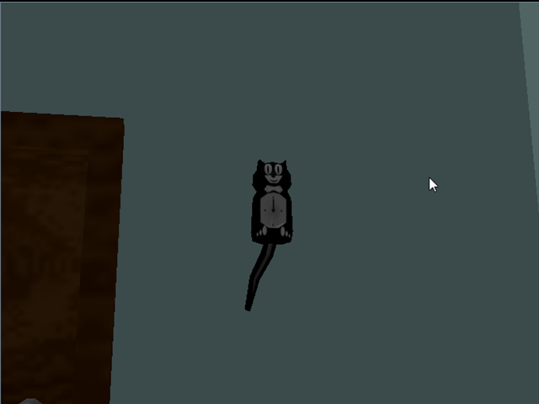
Example Student Work

Slide 5
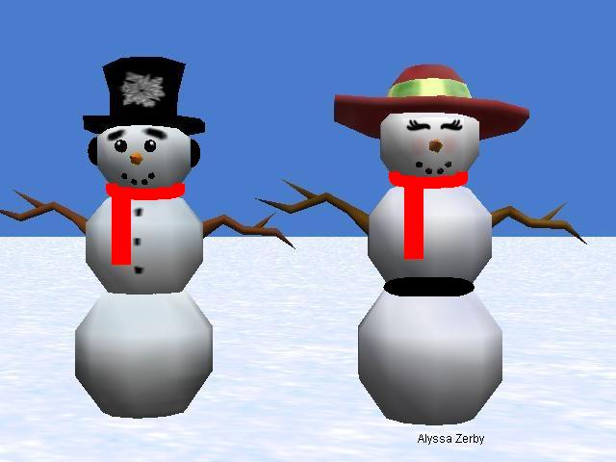
Other Student Work

